Slide 1
Automatic Knowledge Base Construction With LLMs For Amplifiers Datasheets
Presented By: Vaibhav R Khandekar
Guided By: Dr. Frank Wawrzik

Slide 2
Overview
Introduction
Related Concepts: Ontology, GENIAL, LLMs
Data extraction & Data cleaning
Prompt engineering
Triplet Extraction
Construction of amplifier ontology
Inserting amplifiers triplets as individuals using owlready2
Conclusion

Slide 3
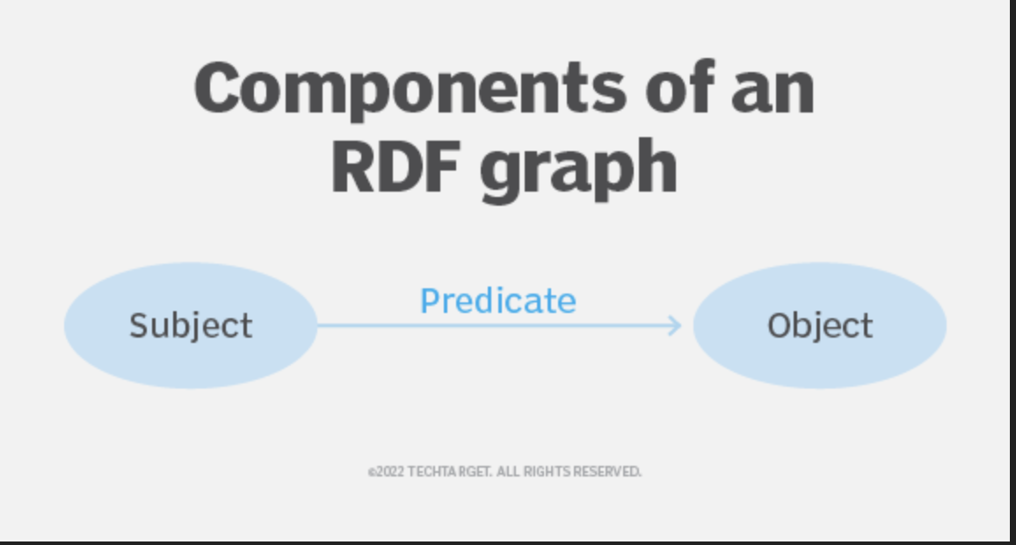
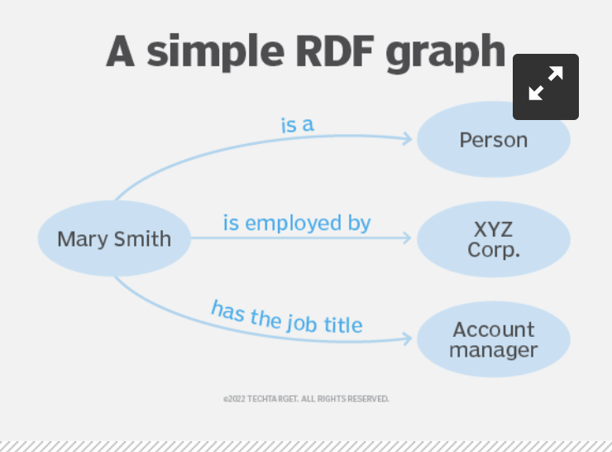
Introduction
The goal is to introduce the automation while creating the ontology file.
Ontology: It explores questions about what exists and how entities relate to each other
GENIAL: Basic ontology containing necessary terms for modelling cars components, properties, functions and dependencies
The same entities and relations structure from GENIAL has been used
LLMs: Large language models designed to understand and generate human like texts.
They can generate text similar to the examples provided to them

Slide 4
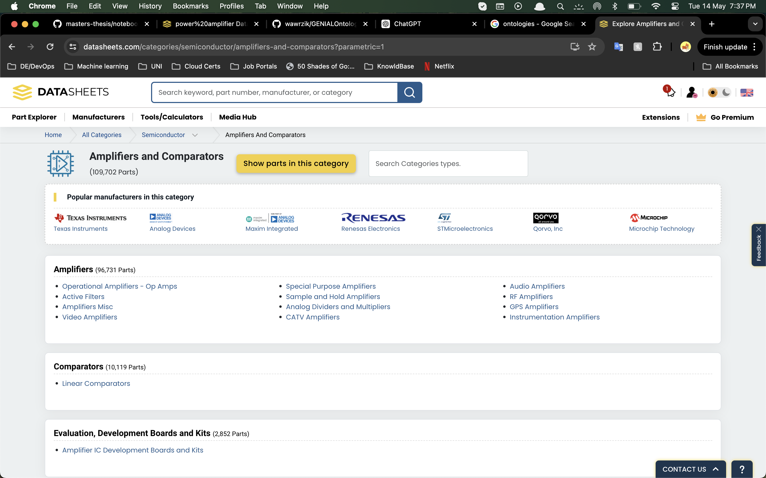
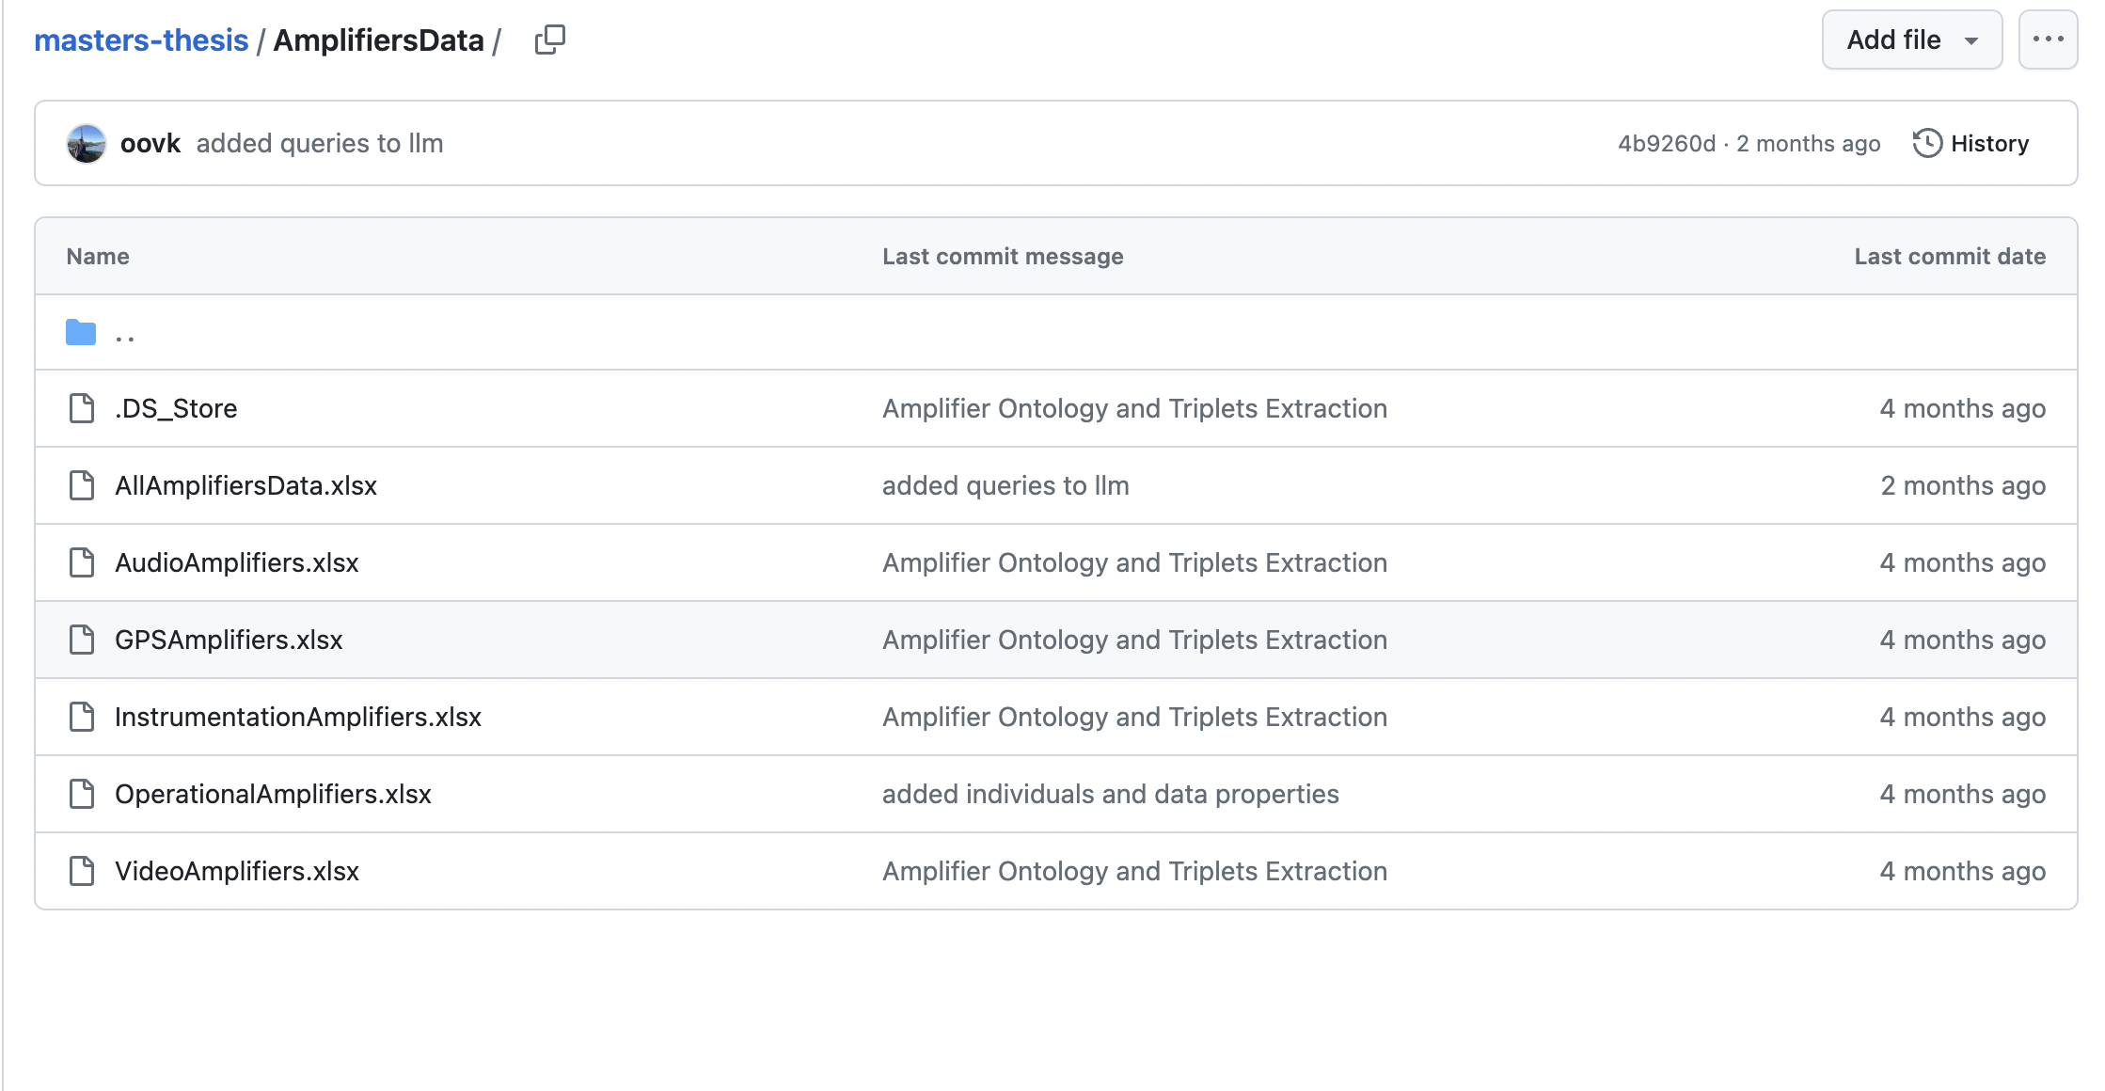
Data Extraction & Cleaning
It is difficult to extract the electrical characteristics table from the component’s pdf by using python since each pdf structured differently
To make my approach more scalable, I’ve used I have used the data from following a website. https://www.datasheets.com/categories?parametric=1
It has different types of amplifiers and the electrical characteristics presented in tabular form.
Data is downloaded for different types of amplifiers containing 10 amplifier individuals for each type.
The downloaded data is cleaned and converted to CSV so that LLM can understand it well

Slide 5
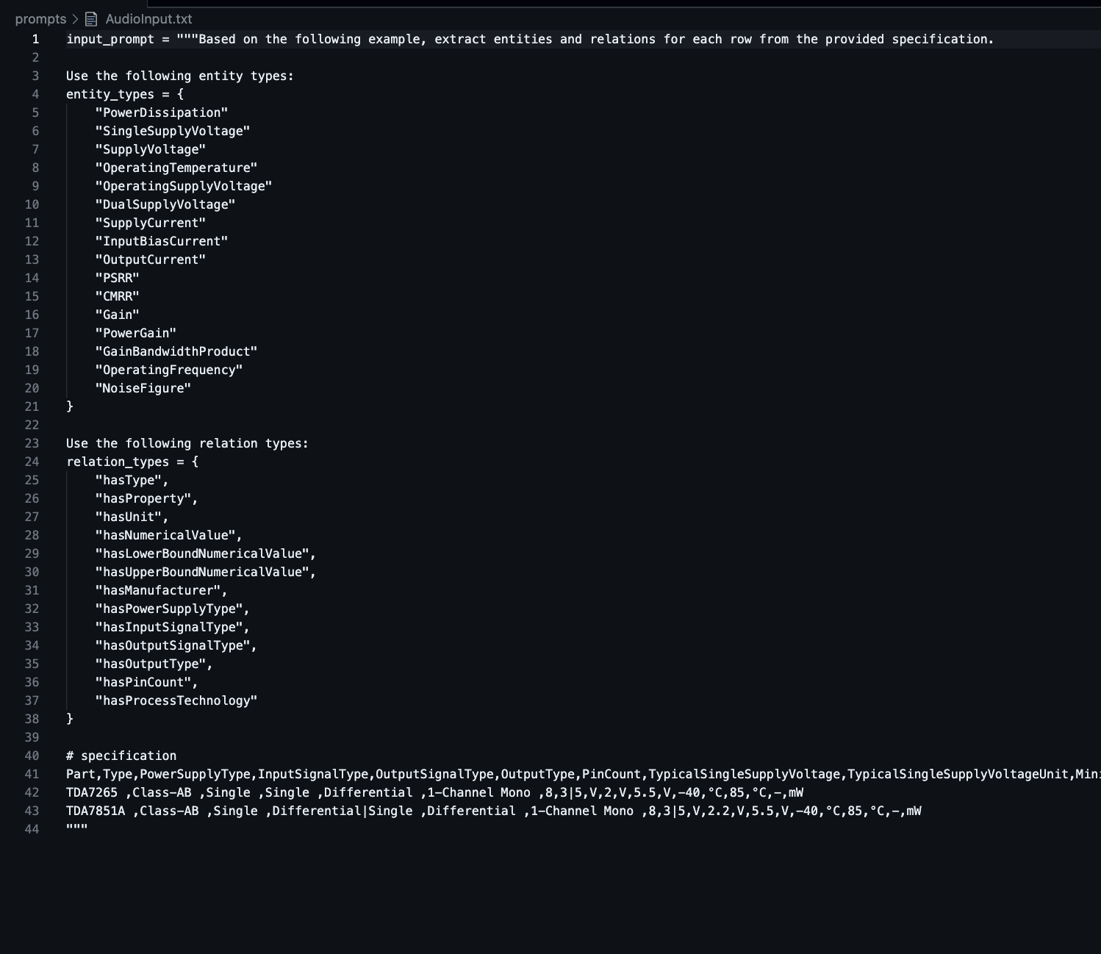
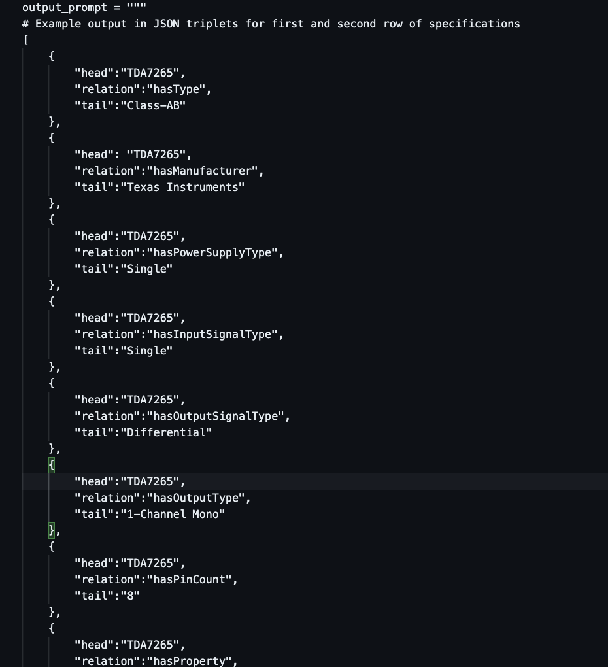
Prompt Engineering
Definition: formulating precise, effective, and contextually relevant prompts to elicit desired responses from the model.
Different prompt are created for each amplifier types, since electrical characteristics differ for each of them.
Input Prompt: Contains the text description, entity & relation type, example data provided
Output Prompt: Contains output format in JSON that we expect from LLM. { Head, Relation, Tail }
https://github.com/oovk/masters-thesis/tree/main/prompts

Slide 6
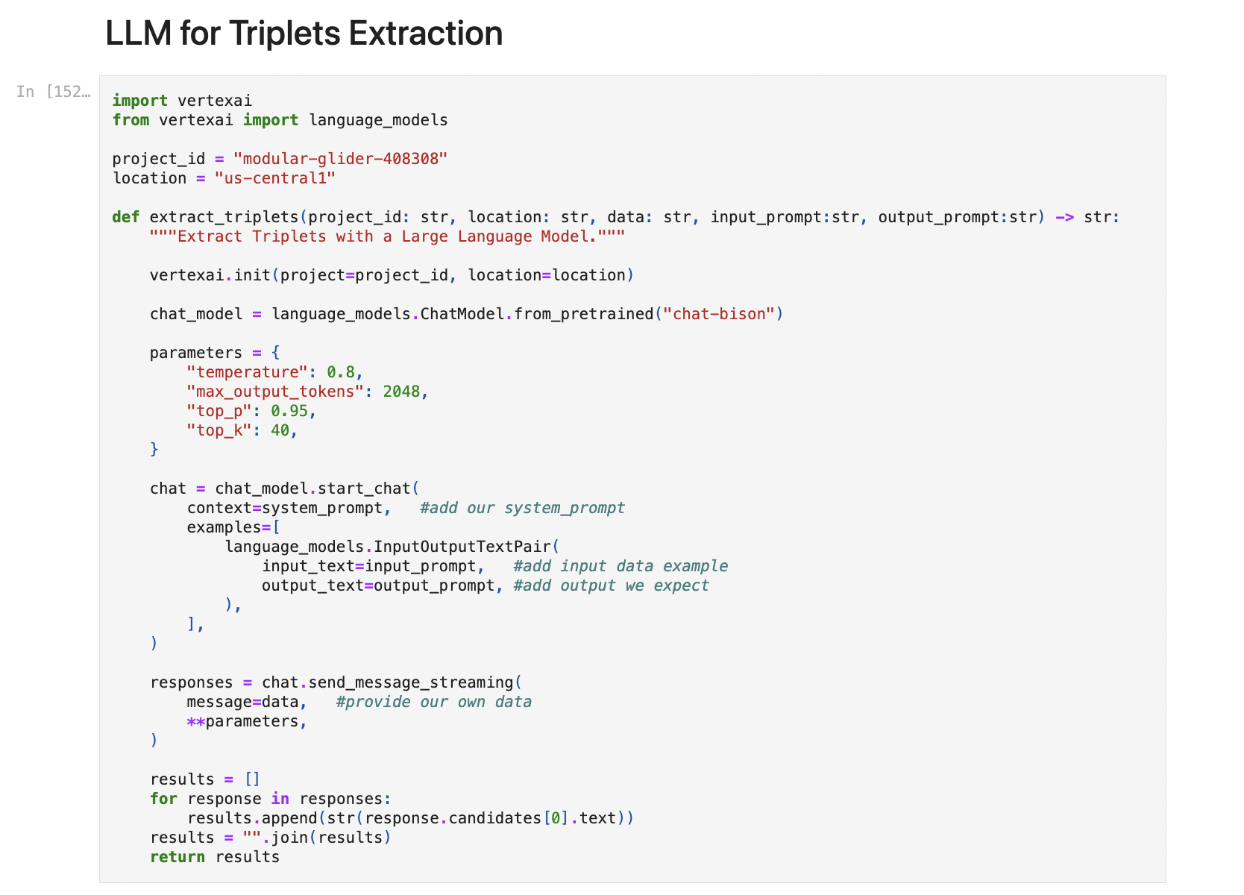
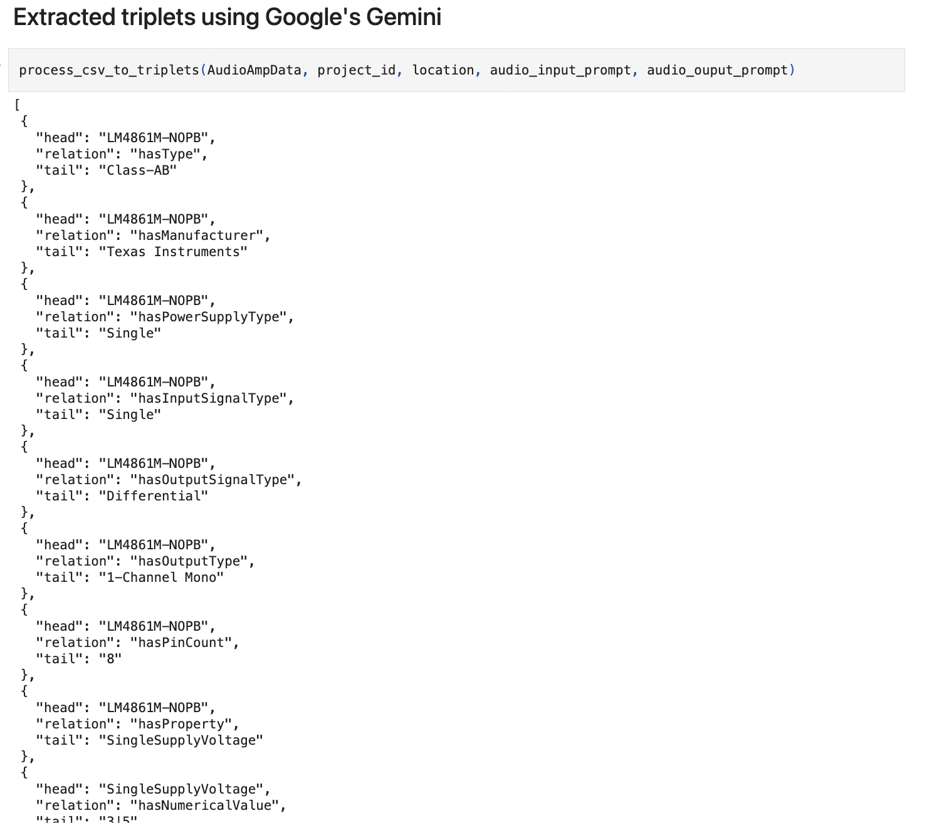
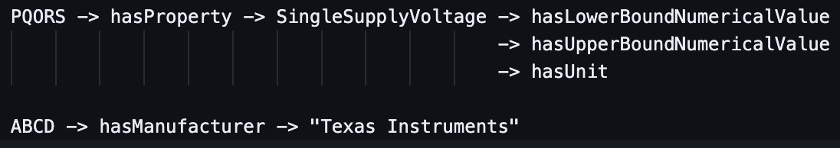
Triplet Extraction with Gemini
The retrieved data and the respective prompts are passed to LLM API
LLM(Gemini API) returns the Triplets containing head, relation, tail
These triplets are in same format as provided in prompts
https://github.com/oovk/masters-thesis/blob/main/notebooks/Thesis.ipynb

Slide 7
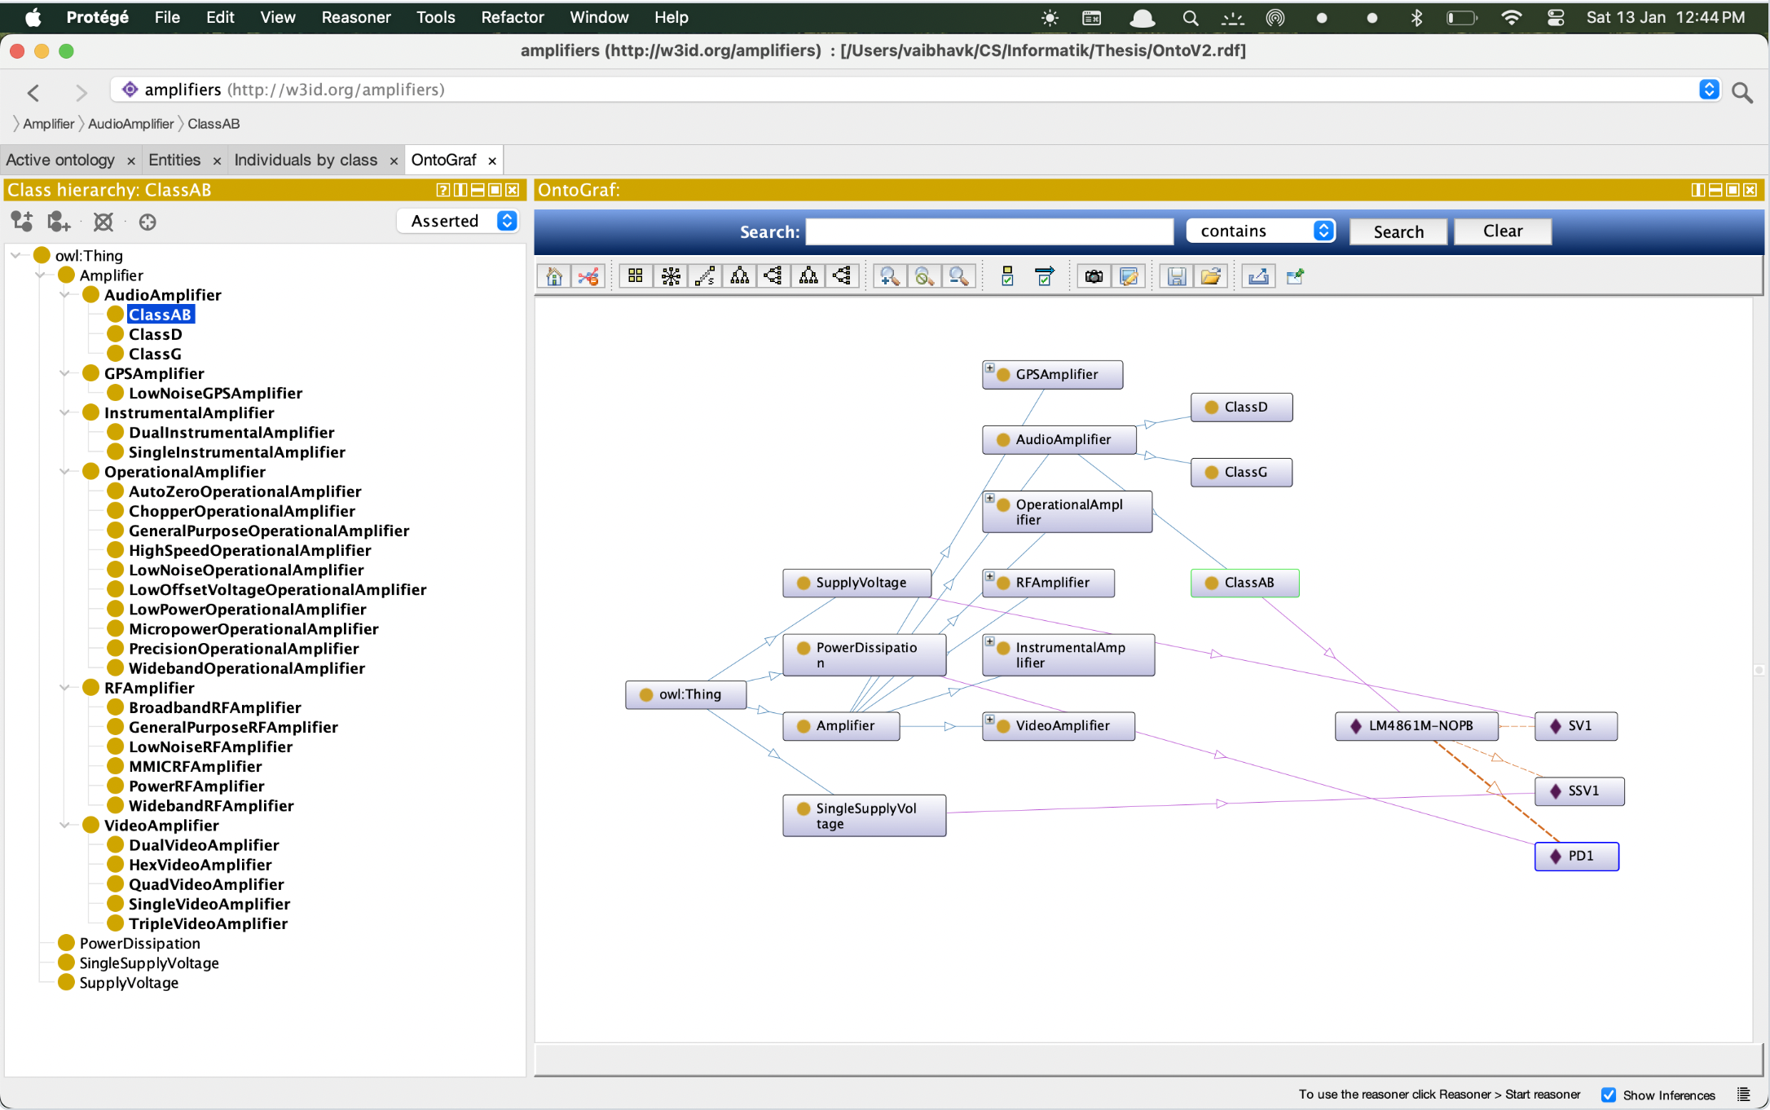
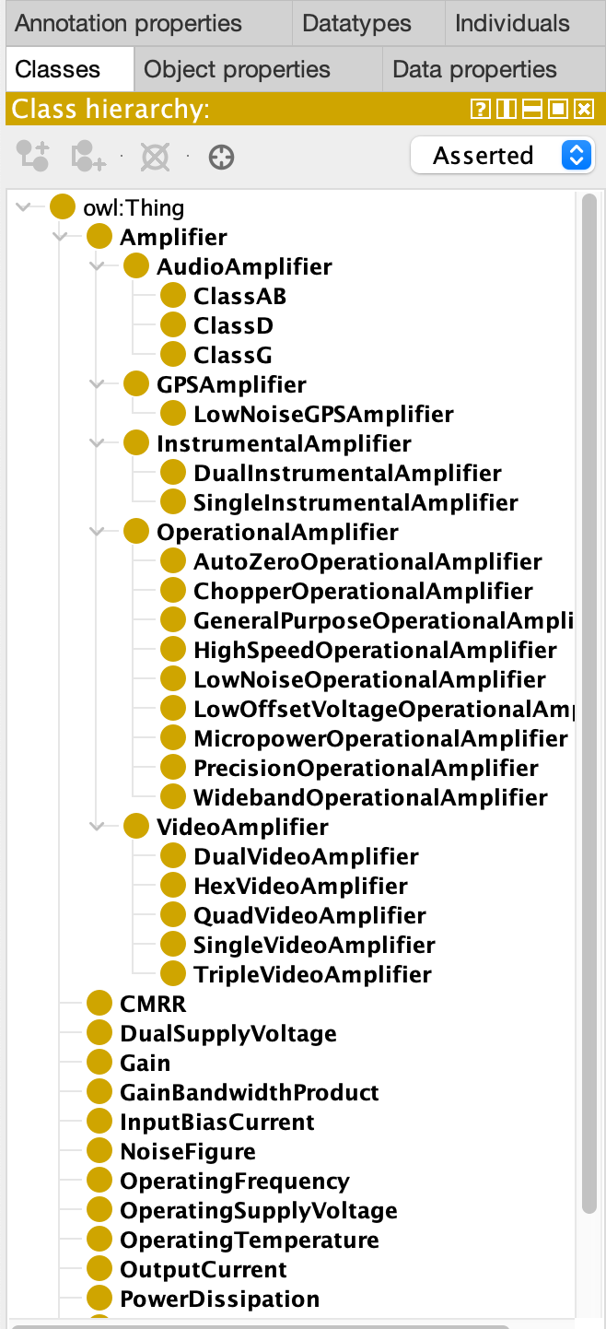
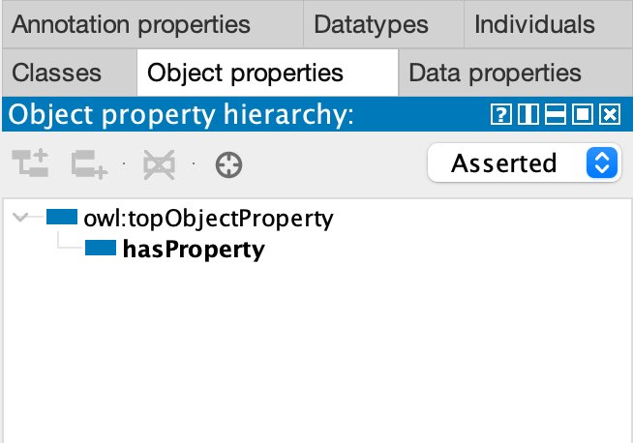
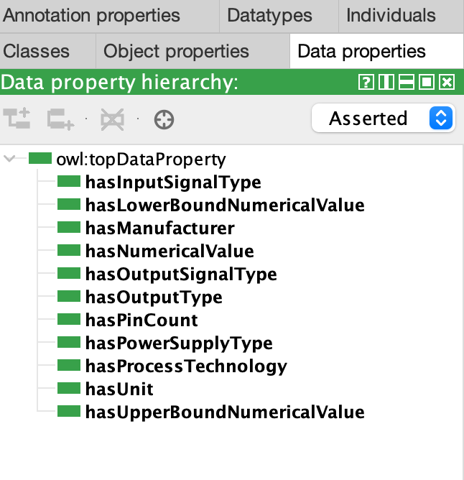
Construction of Ontology
The ontology is constructed keeping the entities and relations from GENIAL in mind.
The overall structure of classes and subclasses, data and object properties are created.
Further the constraints and restrictions are added to ensure the consistency, coherence and integrity.
https://owlready2.readthedocs.io/en/latest/index.html
https://github.com/oovk/masters-thesis/blob/main/OntoFiles/AmpKB.rdf

Slide 8
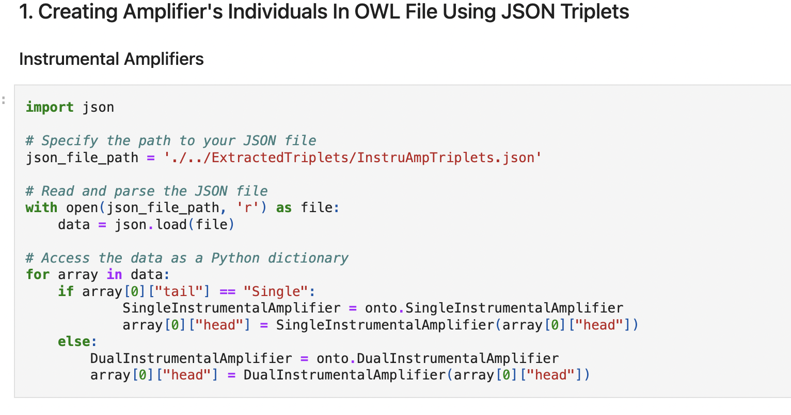
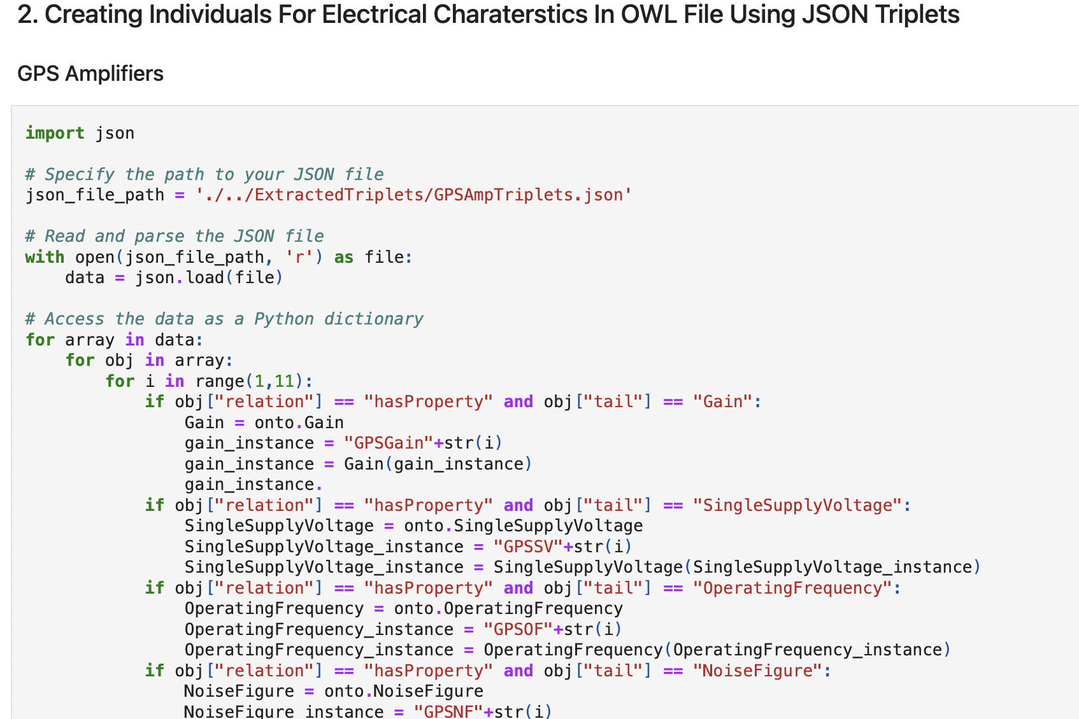
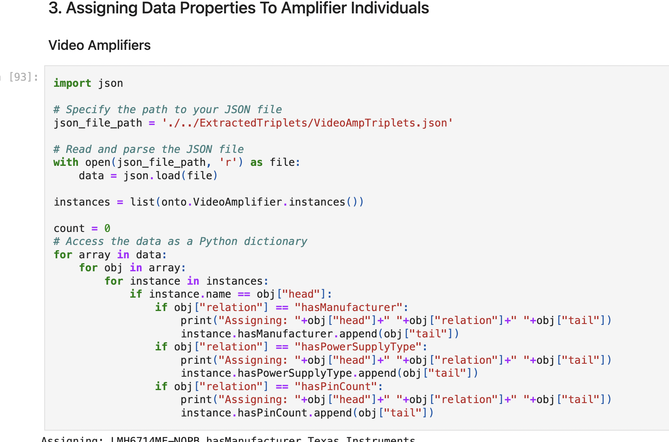
Using owlready2
Owlready2 is python package used to modify owl 2.0 ontologies in python.
Allows us to load, modify, save owl files.
As a final step owl file is loaded using owlready2 and various amplifiers are added as individuals to classes.
Further consistency and inference of knowledge base is checked using reasoner and SPARQL queries.
https://github.com/oovk/masters-thesis/blob/main/notebooks/Thesis.ipynb

Slide 9
Conclusion
Using LLM for triplet extraction in combination with Owlready2 to manipulate owl file allows us to make the process of creating knowledge base automatic.
Using owlready2 to create individuals of the classes in bulk and assigning them values and properties saves time over manually creating using UI like protégé.
I have also compared the performance of SPARQL queries with LLMs, by asking LLM questions over total data.
LLMs are trained on large datasets, this makes LLMs static and cause them to respond incorrectly, give out-of-date answers or hallucinate when asked questions about data they have not been trained on.
Utilizing the Retrieval Augmented Generation approach with specific knowledge base as external data might improve the performance of LLM.

Slide 10
Thank You!

